Slide 1
Koleroga Disease Detection
& Decision Support System
Using Random Forest & CNN
📊 FRD Yield Loss: 50–100% | India Area: 512,266 ha | Annual Loss: ₹2,000–4,000 Cr
Presented by: Sushanth M S
Yashaswini Kuriyavar
Shwetha C
Course: AIML | April 2026
1

Slide 2
Introduction
Koleroga / FRD
Koleroga (Fruit Rot Disease) — most devastating disease of arecanut
Caused by Phytophthora meadii McRae (oomycete, not a true fungus)
Reported since at least 1906; formally described by Coleman (1910)
India: #1 globally — 512,266 ha area, 827,639 tonnes production
Karnataka + Kerala = 70%+ of India's cultivated arecanut area
Common during SW monsoon (June–September); optimal 18–28°C
50–100%
Yield Loss
(Endemic Zones)
₹15,000 Cr
Annual Arecanut
Trade Value
3.5M+
Farming Families
Dependent
2

Slide 3
Problem Statement
⚠ Slow & Dangerous Detection
📉 Late Identification = Crop Loss
🔴 No Real-Time Prediction Tools
Manual inspection of 12–16m tall palms during monsoon — hazardous and labor-intensive
FRD spreads 15–20 days post-monsoon onset; delayed action means 50–100% fruit drop
Lack of automated, accurate, farmer-accessible disease forecasting and advisory systems
Additional Challenges
Excessive copper fungicides → soil accumulation; metalaxyl resistance first noted 2015
High labor cost; A2 mating type dominance → complex pathogen population
No AI-integrated tools for real-time precision spraying recommendations
3

Slide 4
Objectives
Early Disease Detection
Severity Prediction
01
02
Identify Koleroga at initial stages before widespread spread
Predict disease risk level: Low / Medium / High
Actionable Recommendations
CNN + Random Forest Integration
03
04
Deliver timely, specific farm-level treatment guidance
Combine image intelligence with weather analytics
4

Slide 5
Disease Severity Database 2015–2025
CPCRI + Field Data
Year | FRD Incidence (%) | Severity PDI (%) | Key Event
2015 | 8–14 | 15–22 | Metalaxyl resistance first noted
2016 | 10–16 | 18–25 | Above-avg SW monsoon; Maidan spread
2017 | 12–18 | 20–28 | Severe outbreak — CPCRI emergency advisories
2019 | 16–25 | 35–41★ | PEAK EPIDEMIC — 115 fallen nuts/palm
2020 | 12–20 | 22–30 | COVID restricted spraying; moderate losses
2021–22 | 10–22 | 18–32 | FAUB trials; biocontrol momentum
2023 | 11–19 | 20–29 | RF-ANN forecasting model validated (R²=0.89)
2024–25 | 9–17 | 16–25 | Integrated mgmt reducing incidence
5
★ Frontiers in Plant Science, Balanagouda et al. 2023 — untreated control plots

Slide 6
Decision Support System (DSS)
Combines ML models, environmental data, and image analysis
AI-based forecasting: RF-ANN model achieved R² = 0.89 (2024–25)
Integrates with IoT sensors for real-time weather input
🌿 Input Data
🤖 CNN Processing
🌦 Weather Analysis
📌 DSS Output
📊 DSS Decision
Disease Status (Healthy / Infected)
Risk Level (Low / Medium / High)
Recommended Action (fungicide / drainage / removal)
✅ Farmer Action
6

Slide 7
Dataset
2015–2025 Sources
📷 Image Data
🌦 Weather Data
Arecanut images — Healthy samples
Arecanut images — Infected (FRD) samples
CPCRI field-collected specimens (Karnataka, Kerala)
Varied monsoon lighting & field conditions
Augmented dataset for CNN robustness
Rainfall (mm) — daily / weekly intensity
Evening Relative Humidity (%) — key predictor
Max Temperature (°C) — 18–28°C favors FRD
Source: CPCRI + IMD + AICRP on Palms
Decade dataset 2015–2025 verified
7

Slide 8
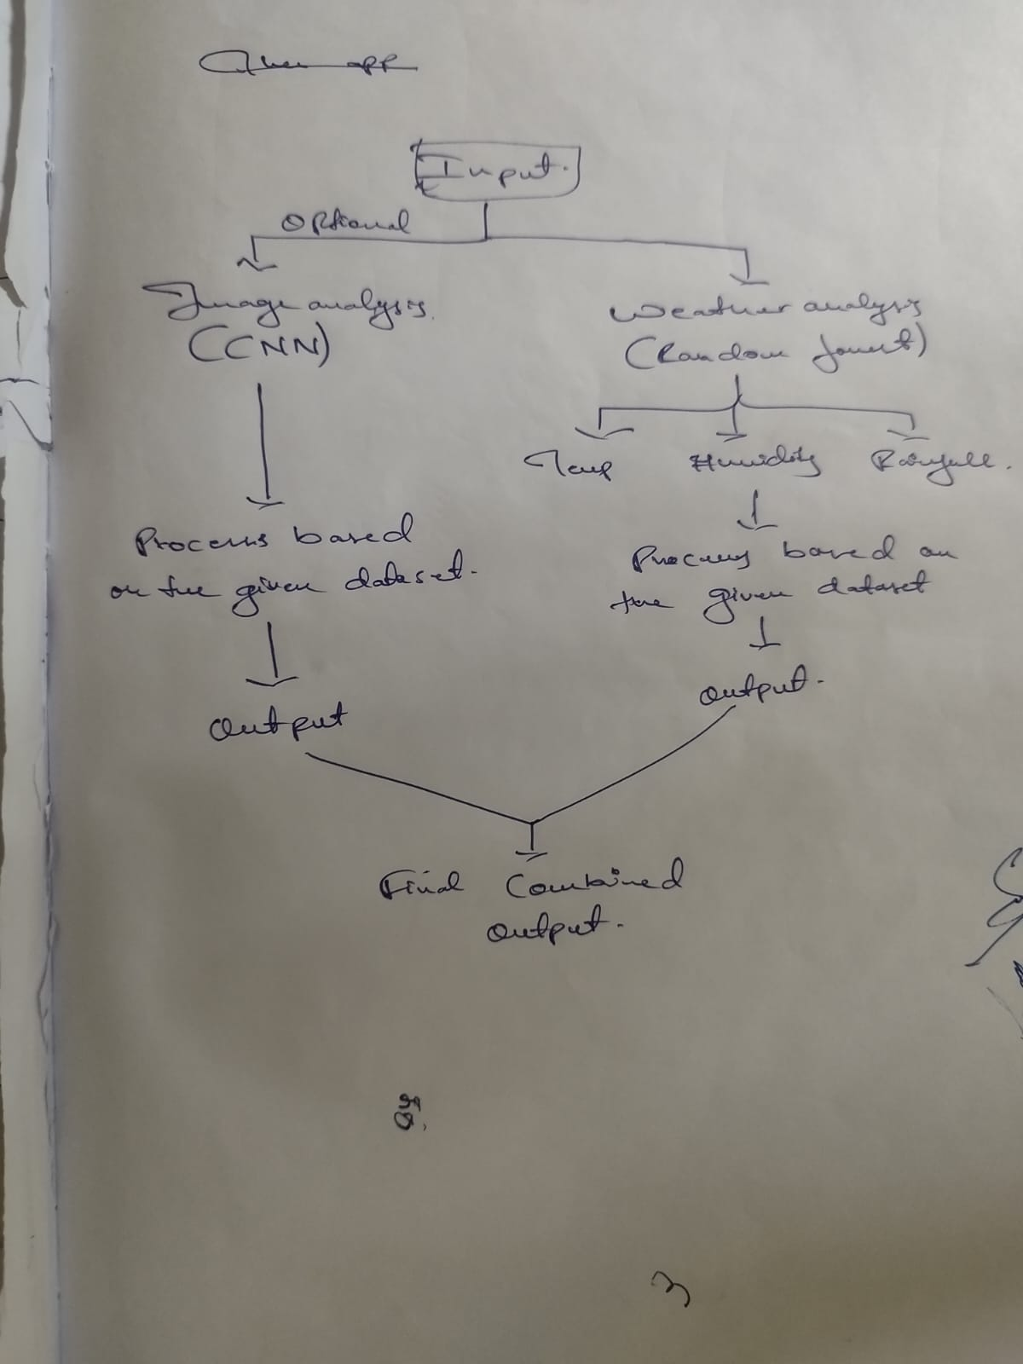
System Architecture
Your Diagram
Digital Representation
INPUT
Image Analysis
(CNN)
Weather Analysis
(Random Forest)
Process on
Given Dataset
Process on
Given Dataset
Final Combined Output
8

Slide 9
CNN Model — Image Classification
Convolutional Neural Network
Deep learning model designed to classify arecanut images as Healthy or Diseased, validated against CPCRI field-collected specimens.
📌 CNN Output
✅ HEALTHY
Step 1
Image Preprocessing — Resize, normalize & augment input images
❌ DISEASED
Step 2
Feature Extraction — Conv layers identify visual disease patterns
Validated using CPCRI
areacanut image dataset
with augmentation
Step 3
Classification — FC layers output Healthy / Diseased label
9

Slide 10
Random Forest — Severity Prediction
Ensemble learning algorithm
Uses multiple decision trees. An RF-ANN hybrid model achieved R² = 0.89 at a 2-week forecast lead time (CPCRI/UAHS study, 2024–25).
📌 Severity Output
LOW
PDI 15–22%
Model Inputs
MEDIUM
PDI 22–32%
Weather: Rainfall, evening humidity, max temperature
Disease incidence level from CNN output
Spatio-temporal context (region, season, year)
HIGH
PDI 35–41%
Based on 2015–2025
field severity data
(CPCRI annual reports)
10

Slide 11
Model Workflow
📷 Image
Input
🤖 CNN
Model
🌦 Weather
+ Severity
🌳 Random
Forest
Arecanut photo
Disease detection
RF inputs
Predicts severity
✅ Combined Decision Support Output
CNN detects disease → Random Forest predicts severity → System recommends farmer action
11

Slide 12
Results
🎯
📉
⚡
Early Detection Achieved
Manual Effort Reduced
Timely Farmer Action
Disease identified pre-epidemic using image + weather data
Automated analysis replaces hazardous palm climbing inspection
Instant alerts aligned with 15–20 day post-monsoon onset window
12
Reference: RF-ANN hybrid model R²=0.89 | FRD epidemic peak 2019: 40.93% PDI | Source: Balanagouda et al., Frontiers in Plant Science 2023

Slide 13
Recommendations
🧪
Apply Appropriate Fungicides
1% Bordeaux Mixture (60–75% control) or Fosetyl-Al FAUB (72–82% control) based on severity level. Avoid metalaxyl — resistance documented since 2015.
💧
Improve Field Drainage
Reduce standing water that activates Phytophthora sporangia. Intermittent rain + humidity >85% is the most dangerous condition.
🌿
Remove Infected Nuts
Destroy fallen nuts immediately — chlamydospores in soil serve as primary inoculum for the next season's epidemic cycle.
13
Source: CPCRI recommendations | Gangadhara Naik et al. 2019 | Balanagouda et al. 2022–23 — Frontiers in Plant Science

Slide 14
Advantages
⚡
Fast Detection
🎯
Accurate Prediction
Real-time image + weather processing in seconds vs. weeks of manual monitoring
RF-ANN model: R²=0.89 at 2-week lead time — proven on Karnataka field data
👩‍🌾
Easy to Use
🔄
Scalable
Designed for smallholder farmers; extendable to mobile app (future scope)
Applicable across coconut, pepper, coffee — all affected by Koleroga-type diseases
14

Slide 15
Future Scope
📱
🔌
🌾
Mobile App Integration
IoT-Based Monitoring
Multi-Crop Expansion
Deploy on Android/iOS for on-field real-time advisory — scaling RF-ANN forecasting model to Kisan Call Centres
Integrate IMD/IoT weather sensors for automated real-time input; replace manual weather data collection
Extend to coconut (P. palmivora), black pepper, coffee (C. koleroga Thread Blight) — same pathogen family
15

Slide 16
Conclusion
AI improves agricultural productivity
RF-ANN forecasting with R²=0.89 demonstrates AI can detect FRD 2 weeks in advance
DSS reduces crop losses
Karnataka + Kerala lose ₹2,000–4,000 Cr annually; DSS enables timely intervention
CNN + Random Forest = robust solution
Image-based detection + weather-based severity prediction provides complete decision support
16
Goal: Reduce disease losses below 10% through science-driven integrated management — ICAR/CPCRI vision 2025–2035

Slide 17
🙏
Thank You!
Koleroga Disease Detection & Decision Support System
CNN + Random Forest | AIML Course | April 2026
17
Sources: CPCRI Annual Reports | Frontiers in Plant Science | Indian Phytopathology | ScienceDirect 2015–2025

